Slide 1
CAPSTONE PROJECT
PRESENTED BY:N.YUVASHREE[510421214051]
dept of biotechnology,Arunai engineering college,Tiruvannamalai.
3/21/2024 Annual Review

Slide 2
PROJECT TITLE
FANDANGO MOVIE RATING ANALYSIS
3/21/2024 Annual Review

Slide 3


AGENDA
PROJECT OVERVIEW
WHO ARE THE END USERS
YOUR SOLUTION AND ITS VALUE PROPOSITION
PROBLEM STATEMENT
THE WOW IN YOUR SOLUTION
MODELLING
RESULTS
3/21/2024 Annual Review

Slide 4

PROBLEM STATEMENT
Back in 2015, FiveThirtyEight published an article entitled "Be Suspicious Of Online Movie Ratings, Especially Fandango’s". The article concluded that Fandango tends to overrate thier movies. In other words, the number of stars that the website shows for a certain movie is often higher than the true rating for the same movie.
Our goal in this notebook is validate these results through a detailed EDA for the given data set.
3/21/2024 Annual Review

Slide 5

PROJECT OVERVIEW
Determine if Fandango's ratings in 2015 had a bias towards rating movies better to sell more tickets. there are two csv files, one with Fandango Stars and Displayed Ratings, and the other with aggregate data for movie ratings from other sites, like Metacritic,IMDB, and Rotten Tomatoes.
3/21/2024 Annual Review

Slide 6

WHO ARE THE END USERS?
In the Fandango movie rating analysis, the end users are moviegoers and consumers who rely on Fandango’s ratings to make informed decisions about which movies to watch. The analysis aims to investigate the accuracy and fairness of Fandango’s rating system, shedding light on their practices and providing transparency to users. Specifically, the project explores the movie ratings provided by Fandango, involving data collection, cleaning, exploratory data analysis, statistical analysis, and visualization¹. By examining Fandango’s movie ratings, the analysis seeks to uncover insights that benefit the end users—those seeking reliable information about film quality and enjoyment
3/21/2024 Annual Review

Slide 7

YOUR SOLUTION AND ITS VALUE PROPOSITION
solution:
The project investigates Fandango’s movie ratings and ticket sales practices.
It aims to uncover any discrepancies or biases in the ratings system.
Data from multiple sources, including Fandango and external articles, are analyzed.
Techniques such as data cleaning, exploratory data analysis, and statistical modeling are employed.
The ultimate solution involves shedding light on Fandango’s practices and providing transparency to users.
Value Propositions:
Transparency
Informed Decisions.
Accountability
Trust.
3/21/2024 Annual Review

Slide 8

THE WOW IN YOUR SOLUTION
1.Empowering Users with Clarity Crystals:
Transparency enables informed decisions.
Users trust unbiased ratings like they trust their favorite spellbook.
2.Unlocking Accountability Chests:
Fandango may enhance its magical system.
Users hold Fandango accountable, like knights guarding a treasure.
3.Fair Movie Choices Enchantment:
Users benefit from accurate ratings—no more dragon-sized disappointments!
They embark on cinematic quests with confidence.
3/21/2024 Annual Review
8

Slide 9
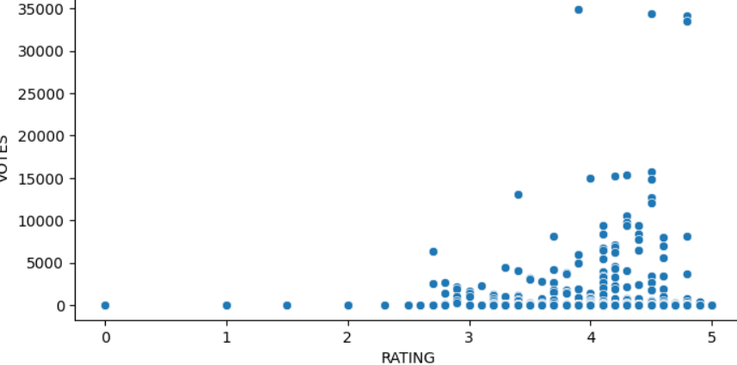
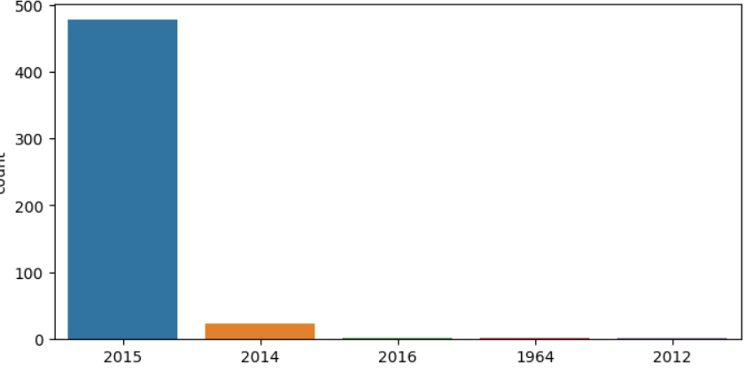
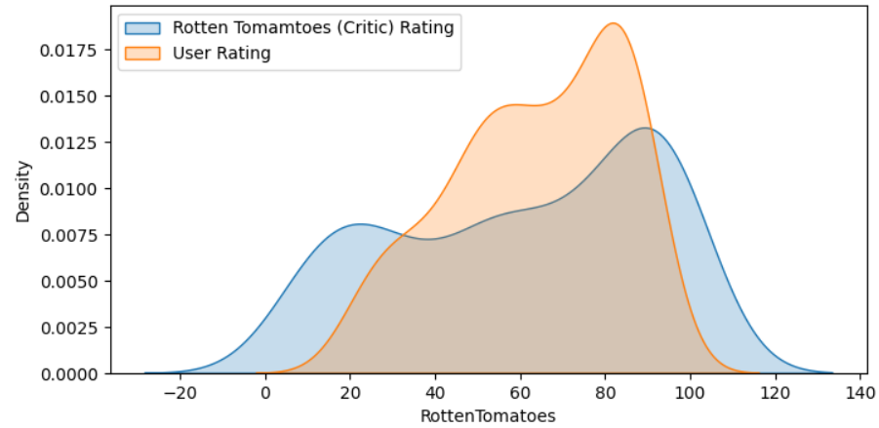
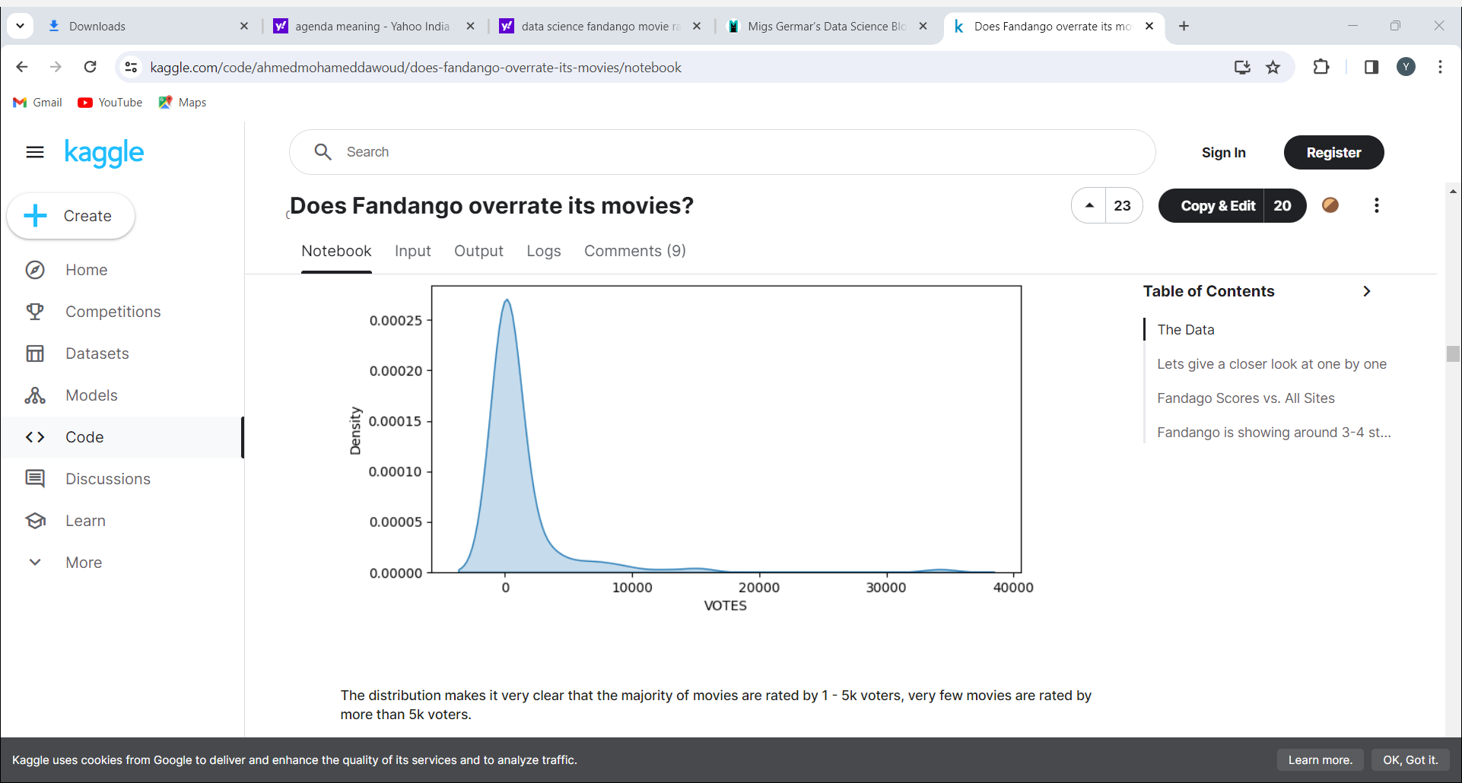
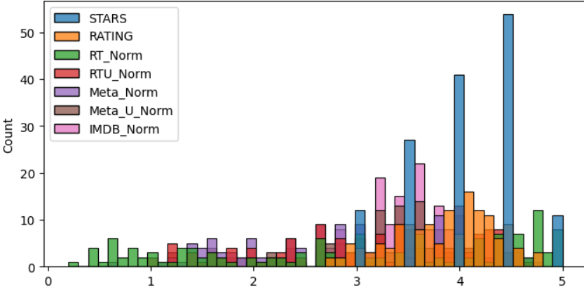
MODELLING
Teams cam add wireframes
3/21/2024 Annual Review
9

Slide 10
RESULTS
The Fandango Movie Rating Analysis project delves into the movie ratings provided by Fandango, scrutinizing the accuracy and fairness of their rating system. The analysis encompasses data collection, cleaning, exploratory data analysis, statistical analysis, and visualization. By examining Fandango’s movie ratings, this project aims to uncover insights into their practices and provide transparency to users.
Demo Link
3/21/2024 Annual Review
10

